Slide 1
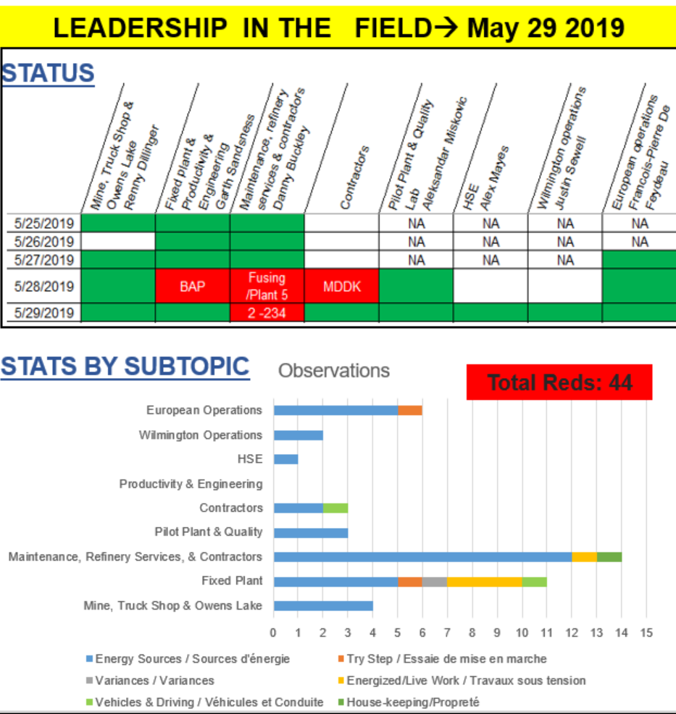
Leadership in the Field
One focused theme for all sites
Vehicles & Driving
Working with Heights
Housekeeping
Isolations
Business wide debrief every week
Require 7 days ‘green’ to change themes
Every Friday checks all previous themes

